Slide 1
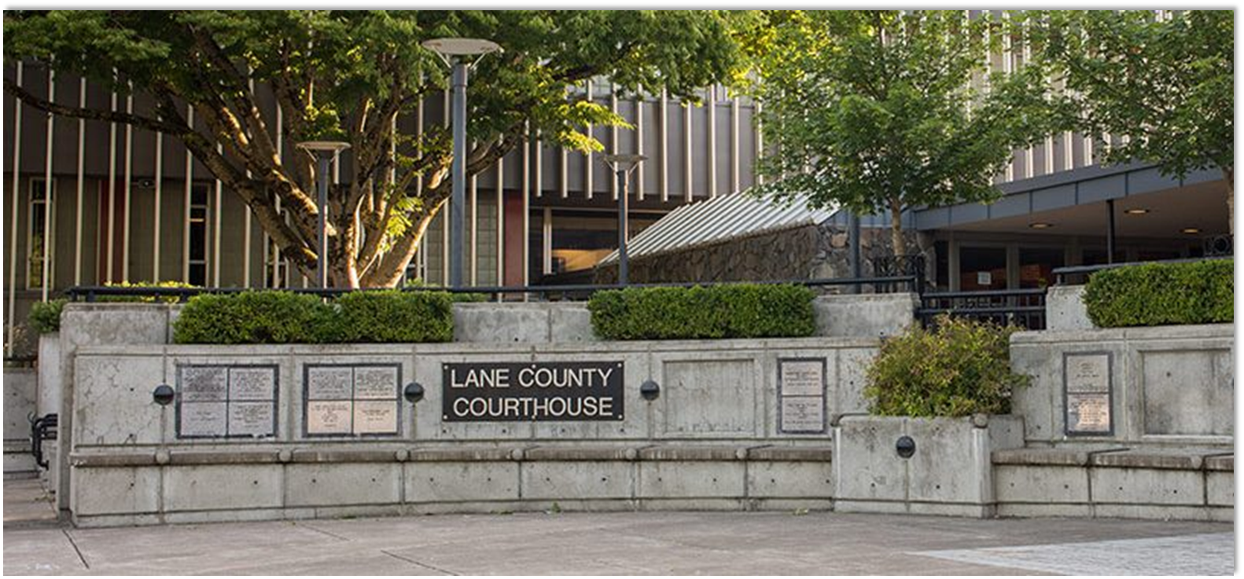
Future Multi-Agency Regional GIS - PHASEIII
Curt Hinton
President
Mary Hinton, Esq.
Strategic Planner (JD)
PLANNING, DESIGNING, AND IMPLEMENTING AWARD WINNING SOLUTIONS THAT CHANGE THE WAY LOCAL GOVERNMENT ORGANIZATIONS CONDUCT BUSINESS
Geotg.com

Slide 2
Overview
Phase III
Governance (June 20 – July 20)
Participation, Training, and Education (July 20 – August 20)
Funding Model (August 20 – September 20)

Slide 3
Overview
Phase III
Governance
Review/summary of Phase 1 and 2 governance findings and recommendations
Feedback from GIS Coordinators (you)
Final Governance Recommendations document

Slide 4
Overview
Phase III
2. Participation, Training, and Education Plan
Review/summary of Phase 1 and 2 training and education findings and recommendations. Other current activities
Feedback from GIS Coordinators at a future meeting
Final Recommendations (succinct document)

Slide 5
Overview
Phase III
3. Funding Model (Bulk of this Project)
For each of the two alternatives
Review and analysis of current funding model
Review of new service catalogue
Discussion of funding strategies
Creation of funding models for each of the two proposed CPAs
This will be a high-level funding model
Percentages by agency
The existing funding model will be used as a starting point

Slide 6
Governance
C J

Slide 7
Existing CPA
Member agencies – Lane County, City of Eugene, City of Springfield, Eugene Water and Electric Board, Lane Council of Governments
Original CPA in the 1970s
Current CPA was executed in September of 2000

Slide 8
Gaps in the Existing CPA and Agreements
General statements about the existing CPA that should be addressed in a new CPA:
Eliminate groups and services that no longer exist (AIRS and RIS);
Make the new CPA a regional geospatial agreement. The original document was much bigger and served to establish a variety of regional services.
Revisit the management structure of the CPA. Currently, it has devolved into an annual work plan approved by the regional GIS Coordinators and then approved by appropriate executives in each of the organizations;
Restate a new purpose, vision, goals, and objectives of this new geospatial CPA;
The recitals section will need reworking based on the sole focus of a geospatial agreement;

Slide 9
Gaps in the Existing CPA and Agreements
General statements about the existing CPA that should be addressed in a new CPA (continued):
The definitions section will require a rework based on the changes over the past two decades;
The general provisions section will need to be reworked to focus exclusively on a geospatial agreement;
The GIS/Common Mapping/RLID Agreement appendix is a starting point for the details of the services that should be included in a new CPA;
Address how the work plan will be managed for the geospatial CPA;
Address how the CPA will be revisited annually for a group of executives to ensure that it remains sustainable and correctly aligned with the overall regional vision.

Slide 10
Priority of Needs
Priority 1
Funding Model
Formation of a renewed executive oversight team that guides the CPA instead of this being relegated to the GIS Coordinators.
The GIS Coordinators Group should continue to meet to:
Ensure that updates are being provided to every agency
That voices are being heard
That collective decisions are being made.
LCOG should continue to be the administrator of the CPA and provide a staff resource to lead the regional effort.

Slide 11
Priority of Needs
Priority 1
Annual workshop(s) for regional executives
Annual workshop(s) open to all partner agencies, RLID members, and the community that focuses on the value added and value proposition of a regional geospatial effort.
RLID – this was uniformly agreed upon by all organizations to be one of the most highly valued components of the CPA.
RLID rewrite – new technology and mobility
Physical infrastructure supporting RLID (underway) – infrastructure line item needs to be added to the CPA
Asset Management Plan – ensure infrastructure renewal
Central Data Warehouse – hardware and software. Partners contribute. Add value.

Slide 12
Priority of Needs
Priority 1
Regional GIS Software - continue to act as the broker of GIS software for the region. Opportunities of scale
Public Safety – continue to act as the maintainer of critical public safety layers for the regional 911 center
Coordination of Aerial Surveys and other regional data sets
Master Data List, Metadata with a focus on ease-of-use
Service Catalog – develop, publish, and maintain
Current overall lack of clarity on what is part of the CPA and what services are provided
Ratify and maintain regional geospatial vision, goals, and objectives
Annual work plan – quarterly update to stakeholders

Slide 13
Priority of Needs
Priority 2
Reestablish Sub-Committees
Knowledgebase – maintain a help-desk and knowledge base accessible by all agencies
Ratify a master plan and update the plan annually
Pursue Grants and External Funding
Expand the software licensing pool to include more extensions
Create and promote a consumer-friendly metadata platform
Development of a regional Open Data collaborative platform
Annual Voice of the Customer Survey
Maintain and update an annual list of KPIs
Regional Alignment Study
EOC support
Coordination of remote sensing programs
C J

Slide 14
CPA models

Slide 15
Model Options
Creation of two alternative Cooperative Project Agreements (CPAs) for consideration by the Partner Agencies
Each of the proposed models can readily be augmented to include or exclude various components
The selected model should become a living document that is revisited every few years for evaluation and augmentation.
Model 1 – Regional Distribution Model
Focuses on extending and enhancing the current CPA model in place at LCOG.
Critical services are identified, with a focus on the data warehouse
Tier 1 and Tier 2 priorities
Model 2 – Center of Excellence Model
Includes all of Model 1 and extends the model to include a number of innovative services, effectively expanding the regional geospatial program into new service areas.
Tier 1-3 items are included in this model

Slide 16
Regional Geospatial Cooperative Project Agreement

Slide 17
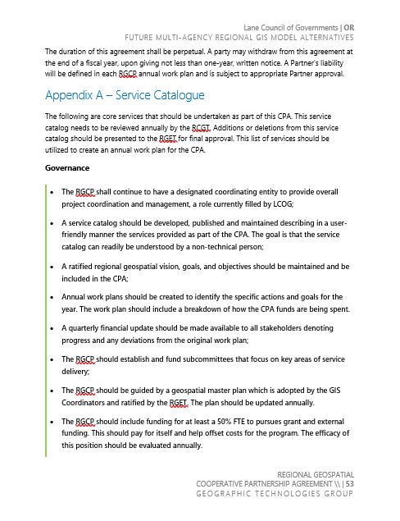
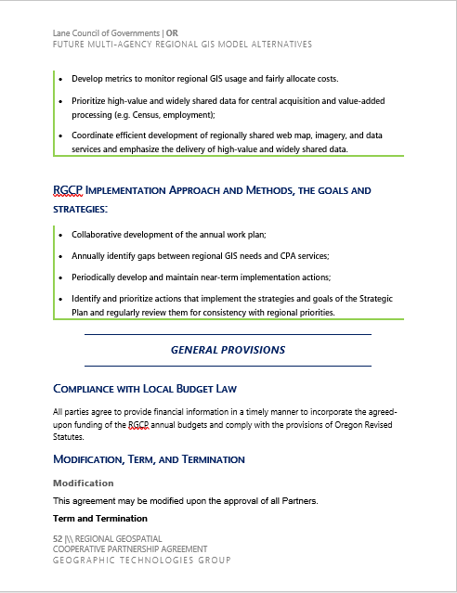
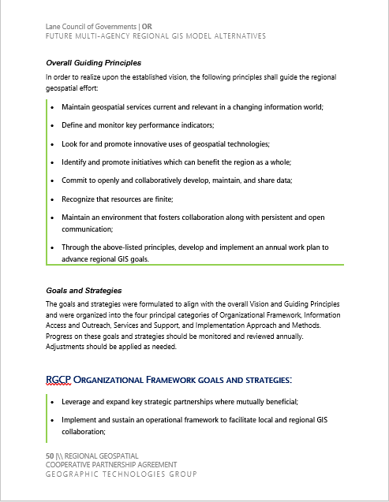
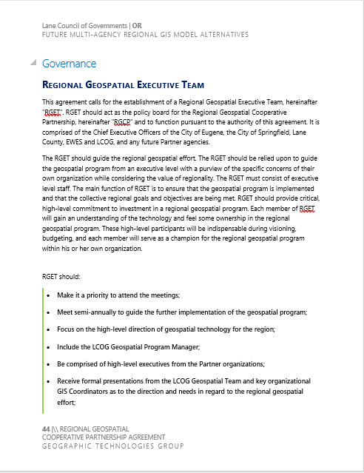
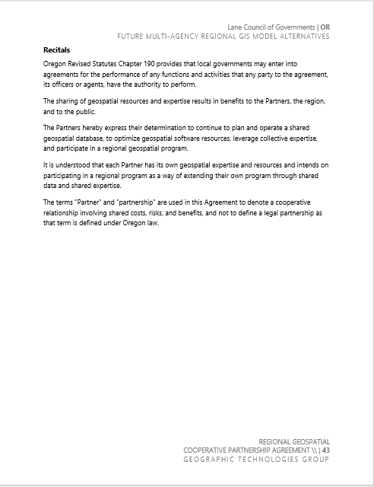
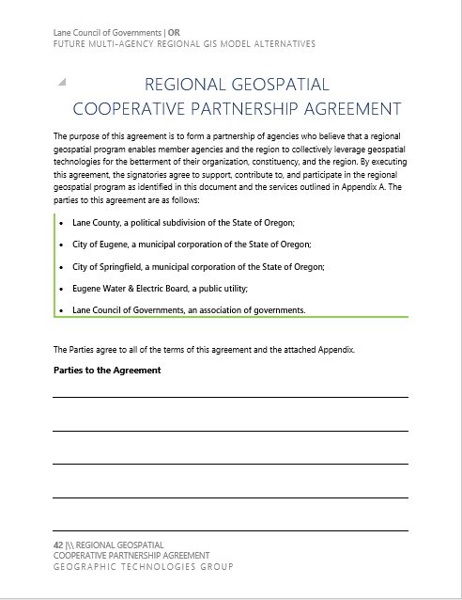
Regional Geospatial Cooperative Project Agreement
Templates
One key element of the new template is abandoning the original intent of the agreement as being a guiding document for a number of technologies in the region
This new title is indicative of how regional service delivery has evolved.
Each agency that signs on to the new regional model needs to understand the value of geospatial regionalism.
Key to the success of the LCOG led regional effort is educating the region as to why regional geospatial services matter and the value they bring to the region.

Slide 18
Regional Geospatial Cooperative Project Agreement
Templates
Common Template Between the Two Models
Main difference is the service catalog

Slide 19
Regional Distribution Model
GOVERNANCE
This agreement calls for the establishment of a Regional Geospatial Executive Team, hereinafter "RGET".
RGET should:
Make it a priority to attend the meetings;
Meet semi-annually to guide the further implementation of the geospatial program;
Focus on the high-level direction of geospatial technology for the region;
Include the LCOG Geospatial Program Manager;
Be comprised of high-level executives from the Partner organizations;
Receive formal presentations from the LCOG Geospatial Team and key organizational GIS Coordinators as to the direction and needs in regard to the regional geospatial effort;
Participate in an annual workshop for regional executives focused on an overview of services provided through the CPA with a focus on return-on-investment;
Decide priorities founded on available funding and overall needs of the region based on the needs identified from the regional GIS Coordinator’s Group;
Receive an annual alignment report focused on how the geospatial effort is assisting in meeting the published goals and objectives of their organization;
Give executive insight into the needs of their organization in regard to geospatial technology;
Approve the annual work plan;
Nurture the regional geospatial effort within their organizations.

Slide 20
Regional Distribution Model
GOVERNANCE
This agreement calls for the establishment of a Regional Geospatial Executive Team, hereinafter "RGET".
RGET should NOT:
Meet at a frequency that is burdensome and unproductive;
Discuss the nuances of the geospatial program such as specific hardware, software or the like;
Be turned over to non-executive level staff, which would defeat the purpose of RGET;
Become a venue for advancing the individual goals of an organization over the overall goals of the region-wide needs.

Slide 21
Regional Distribution Model
MEMBERSHIP OF THE RGET
Chief Executive Officers of the City of Eugene, the City of Springfield, Lane County, EWEB, and LCOG.
RGET OFFICERS
There shall be a Chair and a Vice-Chair of the RGET. The Chair and the Vice Chair shall rotate annually beginning in July of each year using the following rotation list:
Eugene Water & Electric Board;
City of Springfield;
Lane County;
Lane Council of Governments;
City of Eugene.

Slide 22
Regional Distribution Model
REGIONAL GIS COORDINATOR’S TEAM
Coordinate the implementation of RGET directed policies and work plans, coordinate regional planning and sharing of geospatial data and expertise, and collectively give expert advice in regard to the Regional Geospatial Cooperative Partnership.

Slide 23
Regional Distribution Model
REGIONAL GIS COORDINATOR’S TEAM SHOULD:
Meet quarterly at a minimum;
Advise the LCOG Program Manager of the regional needs of their organization;
Maintain a regional strategy document identifying the goals of the regional geospatial effort;
Consider how best to leverage geospatial technology for the betterment of the region;
Contribute to the development and review of the annual work plan;
Give their RGET member updates as appropriate;
Support the LCOG Program Manager with RGET presentations and reports as needed;
Incubate and promote regional geospatial innovation;
Socialize the regional effort within their own organization;
Utilize a regional help desk and any regional collaboration tools that are implemented;
Contribute appropriate data to the regional geospatial warehouse;
Lend technical expertise as merited for the regional geospatial effort.

Slide 24
Regional Distribution Model
APPENDIX A_ SERVICE CATALOG
Core services that should be undertaken as part of this CPA:
Governance
The RGCP shall continue to have a designated coordinating entity to provide overall project coordination and management (LCOG);
A service catalog should be developed, published and maintained describing in a user-friendly manner the services provided as part of the CPA.
A ratified regional geospatial vision, goals, and objectives should be maintained and be included in the CPA;
Annual work plans should be created to identify the specific actions and goals for the year.
Include a breakdown of how the CPA funds are being spent.
C J

Slide 25
Regional Distribution Model
APPENDIX A_ SERVICE CATALOG
Core services that should be undertaken as part of this CPA:
Governance
A quarterly financial update should be made available to all stakeholders denoting progress and any deviations from the original work plan;
The RGCP should establish and fund subcommittees that focus on key areas of service delivery;
The RGCP should be guided by a geospatial master plan which is adopted by the GIS Coordinators and ratified by the RGET. The plan should be updated annually.
The RGCP should include funding for at least a 50% FTE to pursues grant and external funding. This should pay for itself and help offset costs for the program. The efficacy of this position should be evaluated annually.

Slide 26
Regional Distribution Model
APPENDIX A_ SERVICE CATALOG
Core services that should be undertaken as part of this CPA:
Governance
An annual Voice of the Customer Survey should be administered to CPA participants to gauge satisfaction and further identify priorities.
The survey results should be considered in the annual plan update and the annual work plan.
An annual Voice of the Customer Survey should be administered to all RLID subscribers.
The survey results should be considered in the annual plan update and the annual work plan.

Slide 27
Regional Distribution Model
APPENDIX A_ SERVICE CATALOG
Core services that should be undertaken as part of this CPA:
Governance
The RGCP should maintain and annually update key performance indicators (KPIs) to guide the regional geospatial program
The RGCP should do an annual alignment study. This includes a review of each Partner agency’s high-level organizational goals and objectives and creates a report as to how the regional geospatial effort is helping achieve those goals.
The RGCP should include an Emergency Operations Center component. The RGCP team should assist with a region EOC coordination to ensure that the region has a common platform and the optimal geospatial tools.
LCOG should oversee the coordination of the acquisition of aerial photography, LiDAR and any the development of derivative products for the region.

Slide 28
Center of Excellence Model
Changes to Vision, Principles, Goals, and Strategies

Slide 29
Center of Excellence Model
APPENDIX A: Main Differences from the first model
Governance
The RGCP shall focus on becoming a Regional Center of Geospatial Excellence. An important component of becoming a Regional Center of Excellence is remaining current on technology and trends. This will require LCOG staff to continually learn and train on new tools and processes and pass this knowledge on to all key stakeholders. Furthermore, in the past, LCOG would test and analyze new GIS software, specifically from Esri, and inform the Partner agencies if it is ready for a production release. This should be part of the Regional Center of Excellence effort at LCOG.
The RGCP should focus on more regionality. LCOG should act as the coordinator of regional geospatial projects to include candidates such as economic development, parks and recreation, capital improvement projects, environmental, land use, public health, and new transportation projects.
Boutique services should be offered by LCOG to Member and Non-member customers on an as-needed basis based on a set hourly rate schedule that is re-evaluated annually.
LCOG will provide coordination for an expanded remote sensing program to include drone photography, satellite imagery, and other remote sensing platforms.

Slide 30
Next Steps

Slide 31
Next Steps
Discussion Today
Fill Out Online Questionnaire
Discuss Key Points at Next Meeting
Finalize any Changes to Governance Models

Slide 32
THANK YOU
PLANNING, DESIGNING, AND IMPLEMENTING AWARD WINNING SOLUTIONS THAT CHANGE THE WAY LOCAL GOVERNMENT ORGANIZATIONS CONDUCT BUSINESS
Geotg.com
2016 Award Winner

