Slide 1

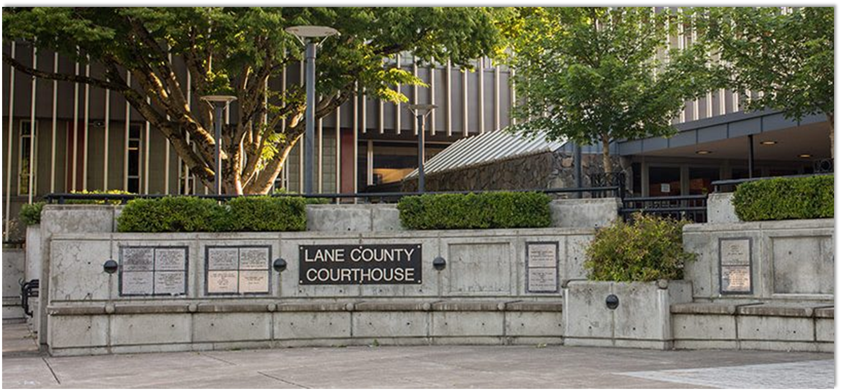
Lane Council of Governments
Future Multi-Agency Regional GIS – Phase III
PLANNING, DESIGNING, AND IMPLEMENTING AWARD WINNING SOLUTIONS THAT CHANGE THE WAY LOCAL GOVERNMENT ORGANIZATIONS CONDUCT BUSINESS
Geotg.com

Slide 2



Overview
Phase III
Governance (June 20 – July 20)
Participation, Training, and Education (July 20 – August 20)
Funding Model (August 20 – September 20)

Slide 3
Overview
Phase III
Governance
  Review/summary of Phase 1 and 2 governance findings and recommendations
  Feedback from GIS Coordinators (you)
  Final Governance Recommendations document

Slide 4
Overview
Phase III
2. Participation, Training, and Education Plan
  Review/summary of Phase 1 and 2 training and education findings and recommendations. Other current activities
  Feedback from GIS Coordinators
  Final Recommendations (succinct document)

Slide 5
Overview
Phase III
3. Funding Model
  For each of the two alternatives
  Review and analysis of current funding model
  Review of new service catalogue
  Discussion of funding strategies
  Creation of funding models
    This will be a high-level funding model
    Percentages by agency
    The existing funding model will be used as a starting point

Slide 6
Governance Recap
Recap Key Governance Items:
The first CPA model (Regional Distribution Model) is the preferred model initially. The team feels that this model should be proven to be successful first before considering the Center of Excellence Model.
No big deviation from what was presented as the core governance components document in the CPA model (Regional Distribution Model)
Refinements will be put into the final CPA document:
  Do not mandate that the CEOs of an organization be the liaison on the executive committee. It can be a high-level representative. However, it cannot be the GIS Coordinator.
  Organizations can bring more than one representative to the Executive Committee meeting but each organization only has one vote.
  Discussion around voting rights – one vote per organization or shares based on the amount they pay. The consensus was one vote per organization.
Meetings of the Executive Committee should not occur more than bi-annually unless an emergency meeting is needed.
Customers hearing from LCOG in regards to the CPA (services, progress, financials) is critical.

Slide 7
Governance Recap
Recap Key Governance Items:
Subcommittees
  No standing committees at the current time but sub-committees should be formed when there is a specified issue to be resolved.
  Functional committees e.g. environmental management, public safety, or Emergency management rather than focused on specific data layers.
RGET and the GIS coordinators group are important and will serve different purposes
  GIS coordinators group focused on the annual work plan
  RGET focused on the bigger issues of intergovernmental partnership and broader service delivery.
Annual surveys were deemed important to include an annual report prepared for both and the results provided to both committees to inform the work plan.
LCOG should establish a Service Catalog which makes clear what services are provided under the CPA and which services would fall outside the CPA.
Once this model is functional components of the Center of Excellence Model should be considered.

Slide 8
Governance Recap
Subcommittee Rankings:
As needed instead of standing
Functional areas, e.g., public safety, public infrastructure, community development, environmental services, etc. rather than data layers.
Other ideas ArcGIS Online, Website, Remote Sensing, Economic Development

Slide 9
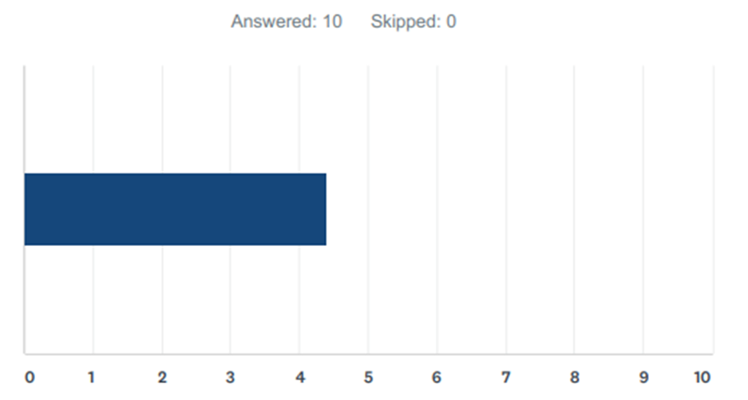
Governance Recap
Grant Funding Position 4.4 out of 10

Slide 10
Governance Recap
Final Thoughts on Governance?

Slide 11

Training and Education
C J

Slide 12
Needs Assessment Findings
Summary of Challenges, Needs, and Opportunities:
Needs Assessment Findings Report
Lack of Awareness –current bundle of CPA service offerings;
Changing Landscape – increased capabilities among key partner tier members;
Data Management – duplication and data quality concerns;
Funding – insufficient and unsustainable funding model;
Technology and System Architecture Renewal – technology and hardware at end of life;
Resilience and Succession –ensure that a succession planning strategy is in place;
Governance –diminished effectiveness of the current approach to governance;
Training, Education and Knowledge Transfer – insufficient investments in this area;
LCOG Regional Center of Geospatial Excellence – opportunities to realign service delivery;
Additional Regional Data Aggregation – opportunities to develop new products and services.

Slide 13
Priority of Needs
Priority 1
Annual workshop(s) for regional executives
Annual workshop(s) open to all partner agencies, RLID members, and the community that focuses on the value added and value proposition of a regional geospatial effort.

Slide 14
Priority of Needs
Priority 3
Regional Training Center - fund a full-time training, education, and knowledge transfer curriculum focused on the specific collective needs of the region.
Regional Collaboration Incubator – implement and promote collaboration tools
Spearhead More Regionality – act as the coordinator of regional geospatial projects to include candidates such as economic development, parks and recreation, capital improvement projects, environmental, land use, public health, and new transportation projects

Slide 15
Regional Geospatial
Cooperative Project Agreement

Slide 16

Regional Distribution Model
REGIONAL GIS COORDINATOR’S TEAM SHOULD:
Meet quarterly at a minimum;
Advise the LCOG Program Manager of the regional needs of their organization;
Maintain a regional strategy document identifying the goals of the regional geospatial effort;
Consider how best to leverage geospatial technology for the betterment of the region;
Contribute to the development and review of the annual work plan;
Give their RGET member updates as appropriate;
Support the LCOG Program Manager with RGET presentations and reports as needed;
Incubate and promote regional geospatial innovation;
Socialize the regional effort within their own organization;
Utilize a regional help desk and any regional collaboration tools that are implemented;
Contribute appropriate data to the regional geospatial warehouse;
Lend technical expertise as merited for the regional geospatial effort.

Slide 17
Regional Distribution Model
VISION, PRINCIPLES, GOALS, AND STRATEGIES
Overall Guiding Principles
Maintain geospatial services current and relevant in a changing information world;
Define and monitor key performance indicators;
Look for and promote innovative uses of geospatial technologies;
Identify and promote initiatives which can benefit the region as a whole;
Commit to openly and collaboratively develop, maintain, and share data;
Recognize that resources are finite;
Maintain an environment that fosters collaboration along with persistent and open communication;
Through the above-listed principles, develop and implement an annual work plan to advance regional GIS goals.
C J

Slide 18
Regional Distribution Model
APPENDIX A_ SERVICE CATALOG
Core services that should be undertaken as part of this CPA:
Governance
A quarterly financial update should be made available to all stakeholders denoting progress and any deviations from the original work plan;
The RGCP should establish and fund subcommittees that focus on key areas of service delivery;
The RGCP should be guided by a geospatial master plan which is adopted by the GIS Coordinators and ratified by the RGET. The plan should be updated annually.
The RGCP should include funding for at least a 50% FTE to pursues grant and external funding. This should pay for itself and help offset costs for the program. The efficacy of this position should be evaluated annually.

Slide 19
Regional Distribution Model
APPENDIX A_ SERVICE CATALOG
Core services that should be undertaken as part of this CPA:
Training, Education and Knowledge Transfer
Annual workshop(s) for regional executives to give an overview of services provided through the new CPA with a focus on return-on-investment;
An annual workshop(s) should be provided for all partner agencies, RLID members, and the community with a focus on the value added and value proposition of a regional geospatial effort;
Maintain a help-desk and knowledge base accessible by all Partner agencies.

Slide 20

Center of Excellence Model
APPENDIX A: Main Differences from the first model
Training, Education and Knowledge Transfer
Act as the regional incubator to encourage more widespread use of geospatial technology throughout the region to include promoting a regional Open Data initiative and promoting software tools for further use of geospatial tools region-wide.
Allocate time (through funding) to promote the regional geospatial effort to non-CPA members (RLID subscribers) through formal promotional efforts. Additionally, LCOG should pursue agencies to become Partner agencies based on formal presentations and value proposals.
As part of the Regional Center of Excellence a training, education, and knowledge transfer curriculum should be created and funded.
Implement and promote collaboration tools like Slack, CivicsPlus, and/or other tools to encourage regionalization and collaboration.
Data
Perform an annual data assessment and create an annual data veracity report to identify gaps and areas for improvement.

Slide 21
Training and Education
Training, Education and Knowledge Transfer Questions for GIS Coordinators
What should be included in the CPA workplan in regards to training and education?
  Classes coordinated?
  Classes taught?
  Regional GIS Day?
  Regional Seminars and/or Webinars?
Should the LCOG Lead be socializing the CPA to attract other agencies?
What should the role of the LCOG Lead or the GIS Coordinators be in educating the organizations?
  VOC
  Annual KPI report
  Annual Alignment report
Other ideas?

Slide 22




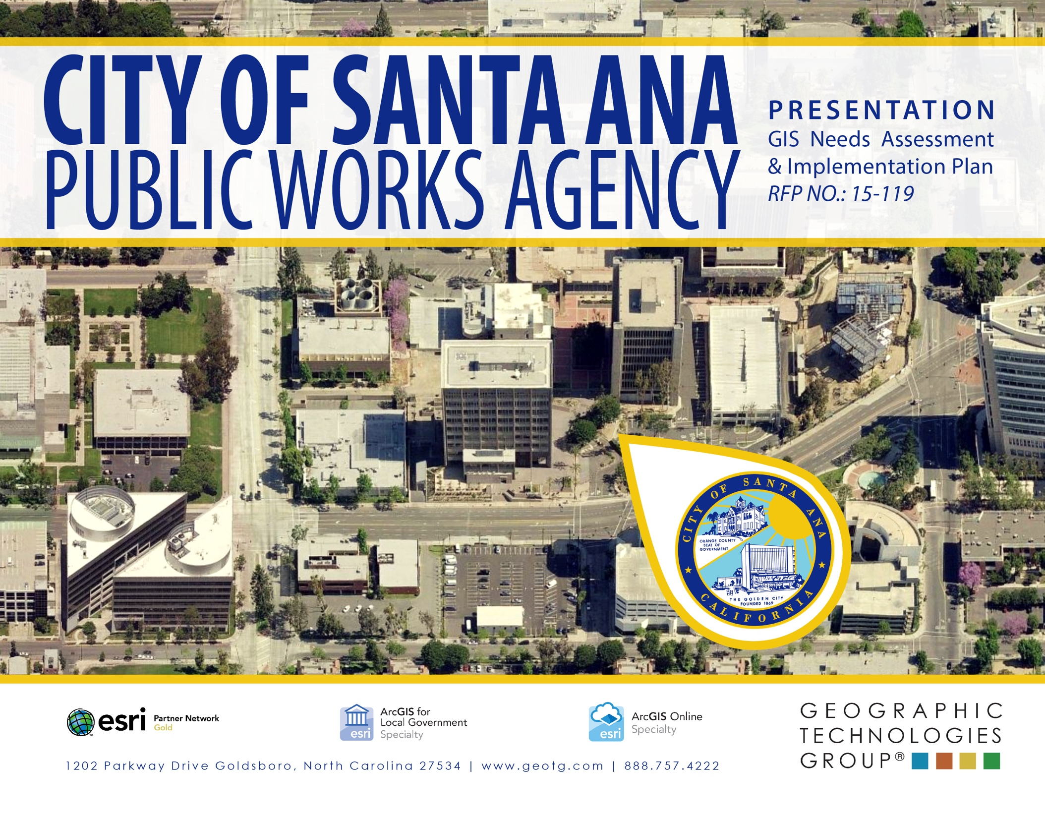
THANK YOU
PLANNING, DESIGNING, AND IMPLEMENTING AWARD WINNING SOLUTIONS THAT CHANGE THE WAY LOCAL GOVERNMENT ORGANIZATIONS CONDUCT BUSINESS
Geotg.com
2016 Award Winner

