Slide 1

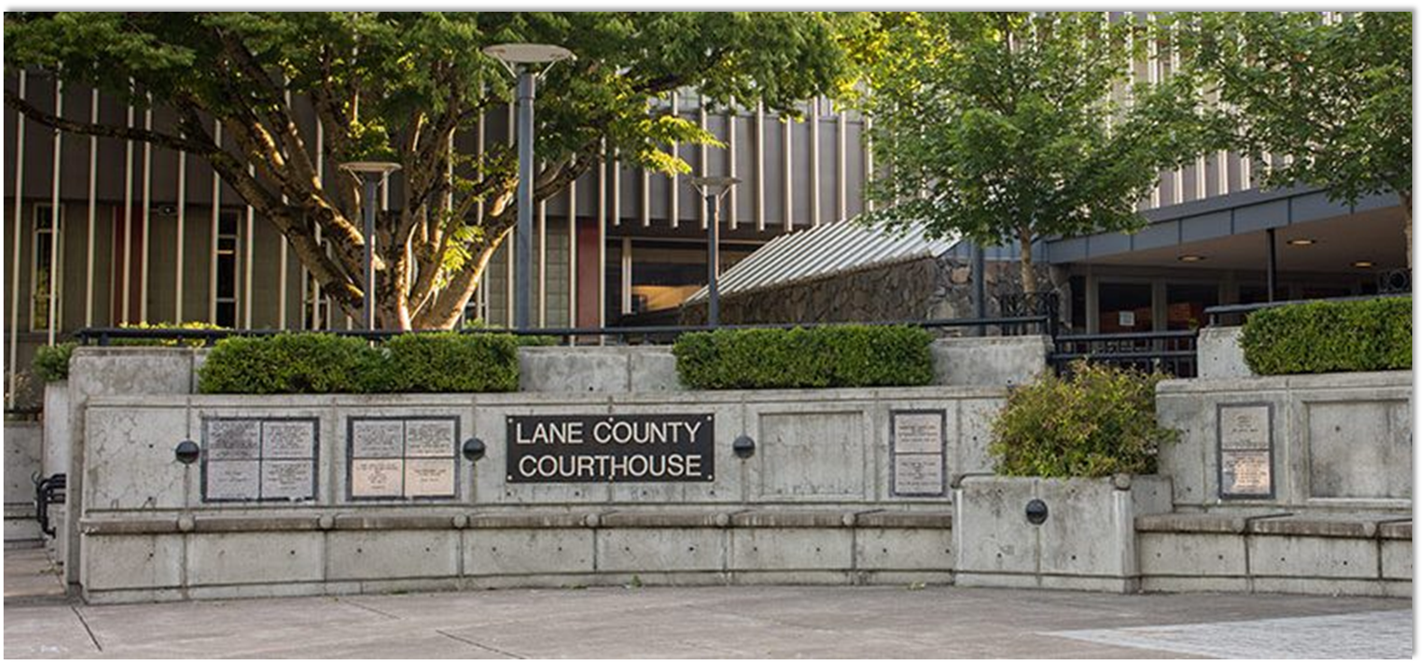
Lane Council of Governments
Future Multi-Agency Regional GIS – Phase III
PLANNING, DESIGNING, AND IMPLEMENTING AWARD WINNING SOLUTIONS THAT CHANGE THE WAY LOCAL GOVERNMENT ORGANIZATIONS CONDUCT BUSINESS
Geotg.com

Slide 2
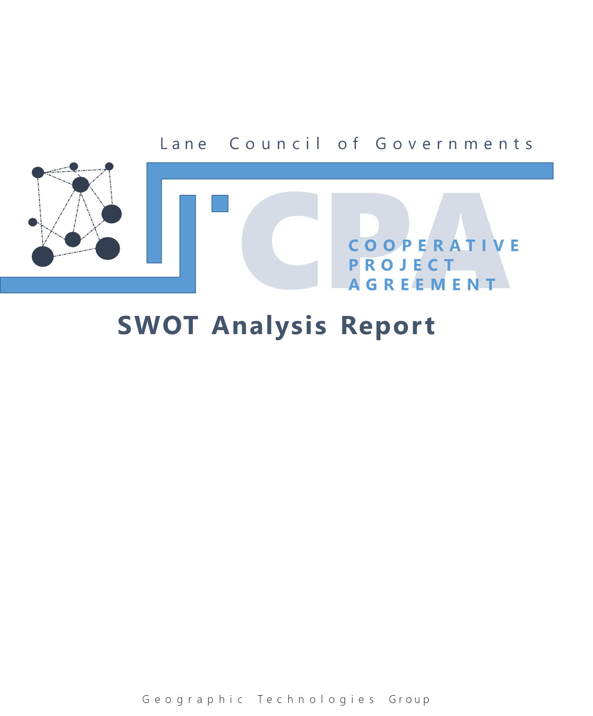


Agenda
Opening Remarks – Jim Carlson
Recap of Phase III – Curt Hinton
Review of current percentage breakdown at a high-level – David Richey
Review of current work plan document and percentages by agency
Next steps

Slide 3
Agenda
Opening Remarks – Jim Carlson
Recap of Phase III – Curt Hinton
Review of current percentage breakdown at a high-level – David Richey
Review of current work plan document and percentages by agency
Next steps

Slide 4
Agenda
Opening Remarks – Jim Carlson
Recap of Phase III – Curt Hinton
Review of current percentage breakdown at a high-level – David Richey
Review of current work plan document and percentages by agency
Next steps

Slide 5
Overview
Phase III
Governance
Participation, Training, and Education
Funding Model

Slide 6
Overview
Phase III
Governance
  Review/summary of Phase 1 and 2 governance findings and recommendations
  Feedback from GIS Coordinators (you)
  Final Governance Recommendations document

Slide 7
Overview
Phase III
2. Participation, Training, and Education Plan
  Review/summary of Phase 1 and 2 training and education findings and recommendations. Other current activities
  Feedback from GIS Coordinators
  Final Recommendations (succinct document)

Slide 8
Overview
Phase III
3. Funding Model
  Review and analysis of current funding model
  Creation of service catalogue
  Discussion of funding strategies
  Creation of funding models
    This will be a high-level funding model
    Percentages by agency
    The existing funding model will be used as a starting point

Slide 9
Overview
Final Goal
Final new CPA agreement that will act as the contract vehicle for the agreement
Will include a work plan with a service catalogue based on the data gathered throughout this project

Slide 10
Agenda
Opening Remarks – Jim Carlson
Recap of Phase III – Curt Hinton
Review of current percentage breakdown at a high-level – David Richey
Review of current work plan document and percentages by agency
Next steps

Slide 11
Agenda
The CPA has goals of reducing duplication of data maintenance to provide cost savings and centralizing information, thereby producing more authoritative.
The public safety community contributes approximately 23% of the total ecosystem (before OEM budget cuts), or ~$250,000.
This contribution pays for some core maintenance (placement of an address), and some customization to specific needs (road ranging, integration & ETL processes).
The program is facing a 6% (possibly) temporary shortfall due to reduction of OEM funding.
Private subscription revenue surpassed partner contributions for the first time in program history in FY19.

Slide 12
Agenda
Opening Remarks – Jim Carlson
Recap of Phase III – Curt Hinton
Review of current percentage breakdown at a high-level – David Richey
Review of current work plan document and percentages by agency – David/Curt/Jim
Next steps – Jim/Curt

Slide 13
Agenda
Opening Remarks – Jim Carlson
Recap of Phase III – Curt Hinton
Review of current percentage breakdown at a high-level – David Richey
Review of current work plan document and percentages by agency – David/Curt/Jim
Next steps – Jim/Curt

Slide 14




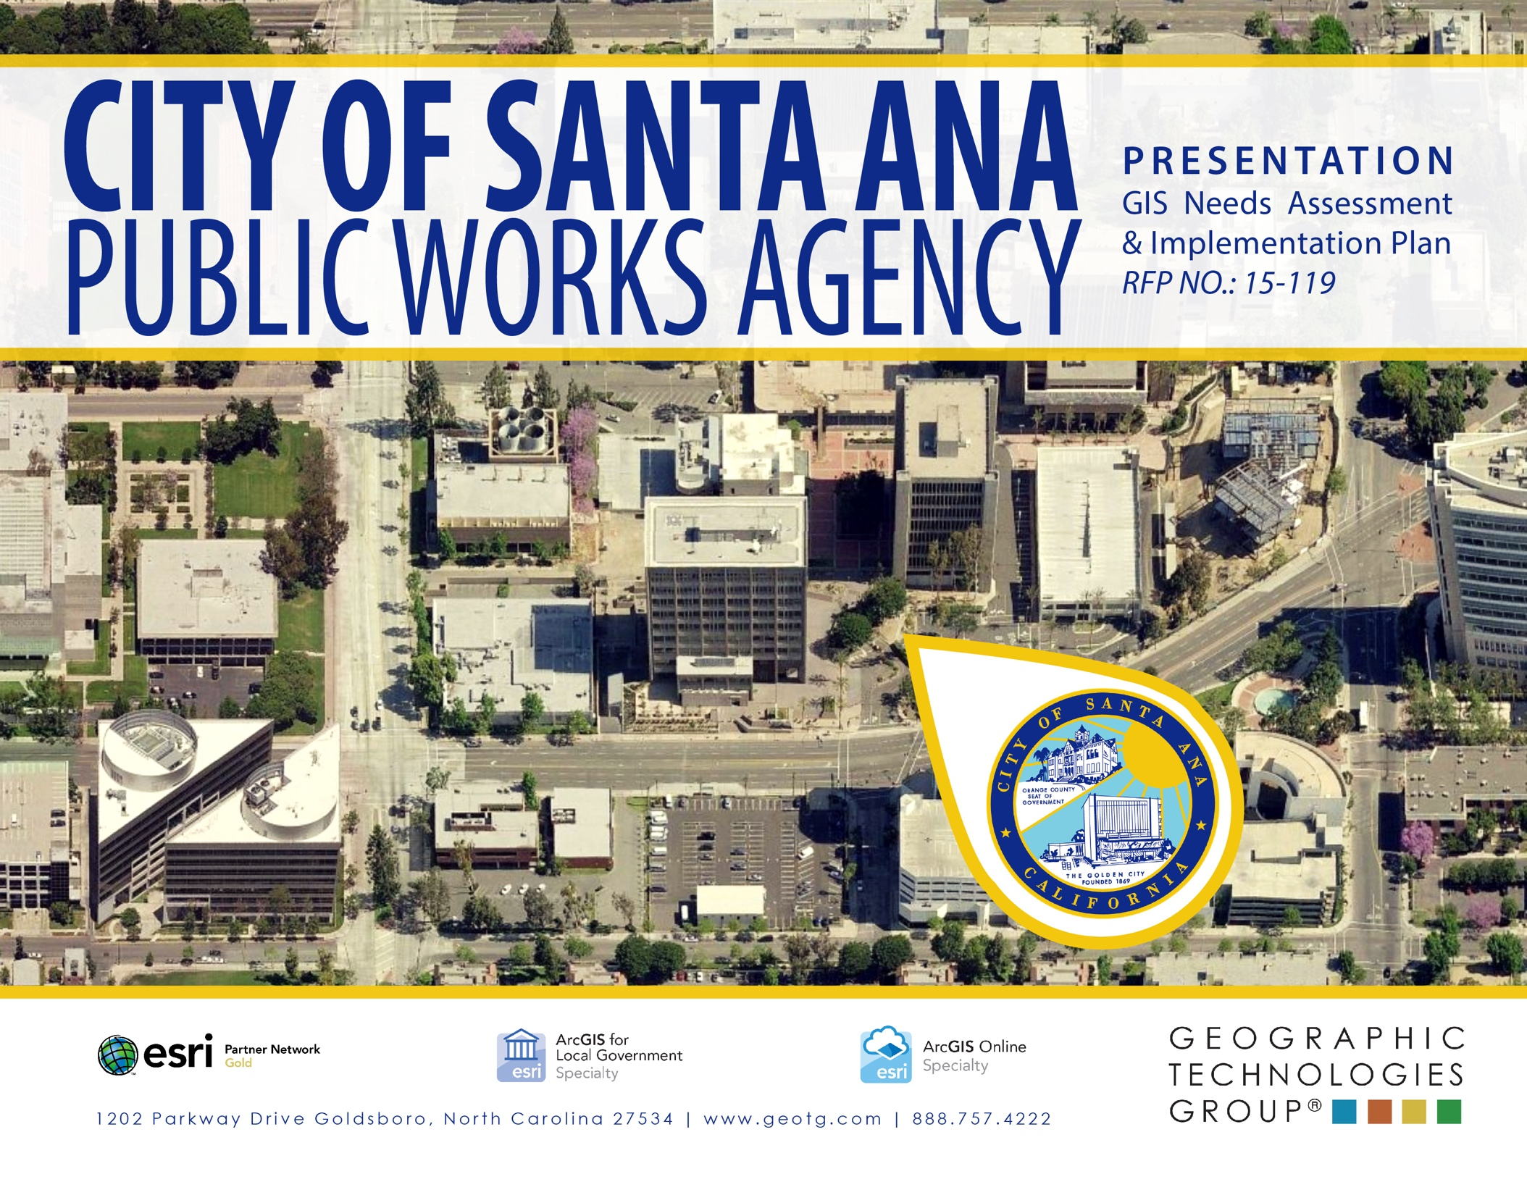
THANK YOU
PLANNING, DESIGNING, AND IMPLEMENTING AWARD WINNING SOLUTIONS THAT CHANGE THE WAY LOCAL GOVERNMENT ORGANIZATIONS CONDUCT BUSINESS
Geotg.com
2016 Award Winner

